Slide 1

I look forward to seeing you at the weekend!
A2.1
Reading
18 PPT Slides
Can understand a simple text about making plans. Can talk about my own
plans and habits in simple
terms.

Slide 2
How do you feel after a stressful day?
Do you look forward to relaxing and doing nothing? Or do you like to make
plans with your friends?
Question Word (Interrogative): "How"
Auxiliary Verb: "do"
Subject: "you"
Main Verb: "feel"
Prepositional Phrase: "after a stressful day“
Detailed Breakdown
Question Word: "How" introduces the question, indicating the nature or condition of something.
Auxiliary Verb: "do" helps to form the question in the present tense.
Subject: "you" is the person being asked.
Main Verb: "feel" is the action being questioned.
Prepositional Phrase: "after a stressful day" provides context about when this feeling occurs.
3

Slide 3
Vocabulary review
free
to have nothing to do
to be looking forward to
stressful
full schedule
will
plan
won’t
4

Slide 4
Plans
I am free tomorrow afternoon.
I am looking forward to seeing you.
Do you have any plans for tonight?
I will see you later.
6

Slide 5
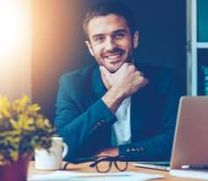
Steve’s plans for the evening
Steve is coming home from work. It was a long and stressful day. He is walking home from the bus stop. It is not very far, but he is very tired. He had a very full schedule today and he is happy to be free this evening. Tonight, he will have dinner and watch a film on his laptop.
He is walking up the stairs to his flat. He is
looking forward to relaxing. Steve walks into
his flat and sits down on the sofa. It feels
nice to finally sit down. He sits on the sofa
for a moment and relaxes.
Read and speak!
7

Slide 6
True or false
TRUE
FALSE
1.
Steve had a stressful day at work
2.
Steve did not have a full schedule today
3.
Steve is free this evening
4.
Steve wants to have dinner in a restaurant tonight
5.
Steve is looking forward to relaxing
8

Slide 7





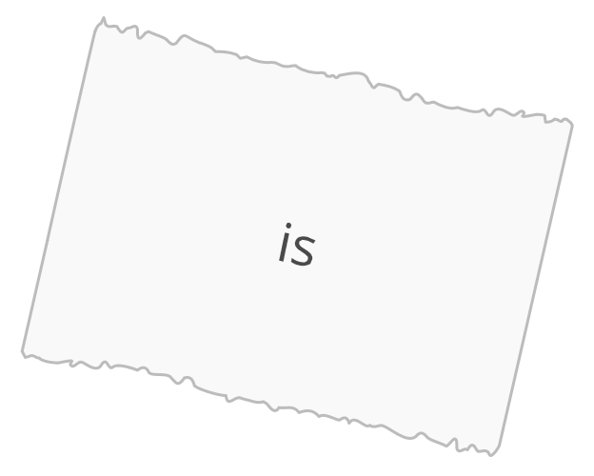














Unscramble the words to make two sentences
relaxing.
9

Slide 8






Which is the odd one out? Why?
relax
free
sit on the sofa
stressful
10

Slide 9
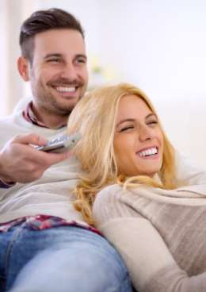








About you
What kind of film do you watch when you want to relax?
romantic
comedy
horror
science fiction
11

Slide 10
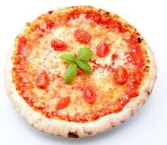
What are you doing tomorrow?
Steve is feeling hungry. He does not want to cook tonight, so he is going to order a pizza. He picks up his phone to call the restaurant, and there is a text from Tom. He wants to go out to a café tonight with Steve and Sara. Steve doesn’t feel like talking on the phone, so he writes Tom a text. He tells Tom that he doesn’t feel like doing anything tonight. He sends Tom the message.
Read and speak the above passage!
12

Slide 11
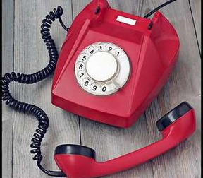
What are you doing tomorrow?
He is looking for the number to call the restaurant when his phone rings. It’s Sara.
“Hi Sara! I am not coming to the café with
you and Tom tonight. I am very tired,” he
says.
“No problem Steve! You should relax tonight. What are you doing tomorrow afternoon?” she asks.
“I have nothing to do tomorrow. Maybe we
can get together,” says Steve.
“OK, if you are not tired tomorrow, you
should call us,” answers Sara.
13

Slide 12
Choose the correct option
1. Tom wants to go to a _______________ tonight.
a.
restaurant
b.café
2.
Steve doesn’t _______________ going to the café.
a.
feel like
b.
feeling like
3.
Steve says maybe they can _______________ together tomorrow.
a.get
b.be
4.
Sara wants Steve to _______________ her tomorrow if he wants to do something.
a.
text
b.call
15

Slide 13


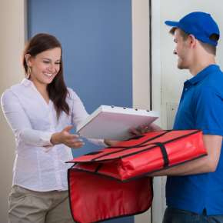
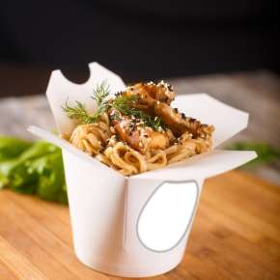
About you
What kind of food do you eat when you are too tired to cook?
16

Slide 14
Will you be free at the weekend?
Steve finishes talking to Sara and finds the phone number of the restaurant. He calls and orders a pizza. His pizza is arriving in thirty minutes. Now he can relax again. He is determined to have a quiet evening.
He is looking for a film to watch on his computer when he gets
another text message. Erin is asking if he has any free time at
the weekend. She wants to go out for dinner with him. This is a
nice surprise. He writes back to her. He wants to go on a date
with Erin.
“I look forward to seeing you at the weekend,” he writes.
He finds a good comedy on his computer. He lies down on the
sofa and watches it. His pizza is arriving soon.
17

Slide 15
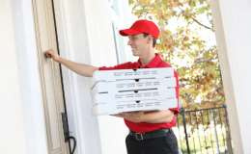

Fill in the gaps
1.
2.
3.
Steve’s pizza _______________ in 30 minutes.
Erin is asking if Steve has any
_______________ at the weekend.
Steve tells Erin ‘I _______________ to seeing
you at the weekend’.
4.When Steve finally lies down he knows
his pizza _______________ soon.
18

Slide 16







Answer these questions
What are you looking forward to?
When do you like having nothing to do?
What do you do to relax?
How do you feel when you have a full
schedule?
19

Slide 17
Fill in the gaps
1.Steve has a _______________ at work.
free forward full schedule nothing looks
2.
3.
4.
Steve is looking _______________ to
relaxing.
Steve has _______________ to do
tomorrow.
Erin asks if Steve is _______________ at the
weekend.
5.Steve says he _______________ forward to
seeing Erin.
26

Slide 18
In today’s lesson, we focused on reading and understanding a simple text about making plans. Using 18 slides, students practiced discussing their personal plans and habits.
By the end of the lesson, students were able to talk about their own activities and routines in simple terms, improving both their comprehension and conversational skills for planning scenarios.
Congratulations in finishing the lesson and remember practice makes perfect☺

