Slide 1

I like science fiction films!
A2.1
Reading
21 PPT Slides
Can read a simple text about going out with friends.
Can give a simple opinion on the characters in the text and their actions

Slide 2
Are you going to the big premiere?
The sentence structure of "Are you going to the big premiere?" is as follows:
Auxiliary Verb (Auxiliary): "Are"
Subject: "you"
Main Verb: "going"
Prepositional Phrase: "to the big premiere"
Active Voice Structure
In active voice, the typical structure is:
Auxiliary Verb + Subject + Main Verb + (Additional Information)
Example Breakdown
Auxiliary Verb: Indicates the tense or mood (in this case, present continuous).
Subject: The person or thing performing the action.
Main Verb: The action being performed.
Additional Information: Provides context or details (in this case, the location or event).

Slide 3
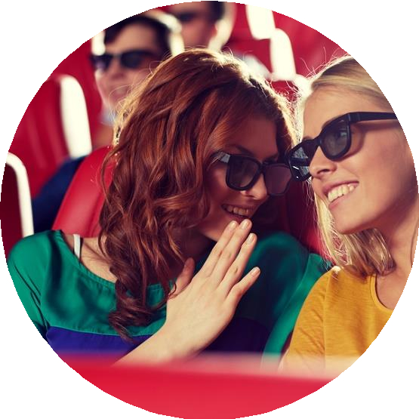
Vocabulary
excited
genre
exciting
romance
audience
thriller
ticket

Slide 4
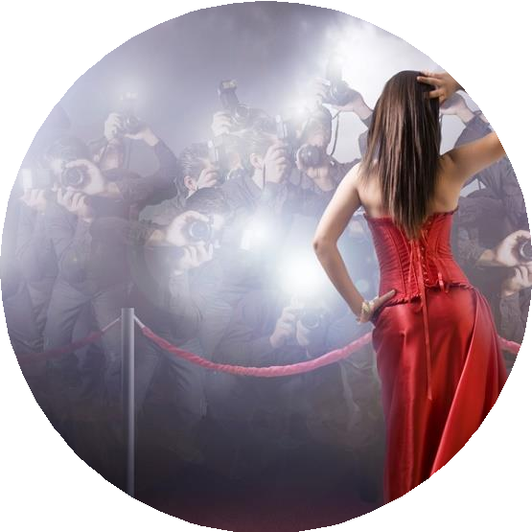

The big event
The big premiere is tonight!
Have you got the tickets?

Slide 5

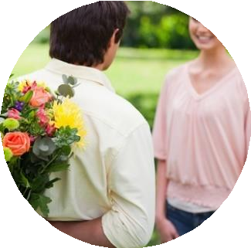
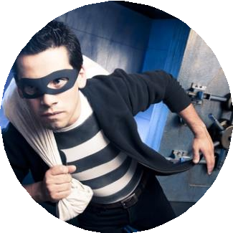
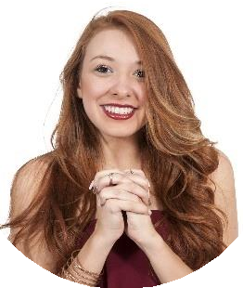
What’s your favourite film genre?
I love films!
I’m a big fan of romance films.
I prefer thrillers – they’re so exciting!
I couldn’t wait to see the trailer – I was
so excited!

Slide 6

Reading
Steve is getting ready to go out. It is taking a long time because he is nervous about meeting Erin tonight. He began getting ready an hour ago and he is still not finished. He is fixing his hair and choosing nice clothes to wear. He doesn’t want to be late.
He puts on his clothes and looks in the mirror. It’s time to go
now. He puts on his coat and leaves the apartment.

Slide 7


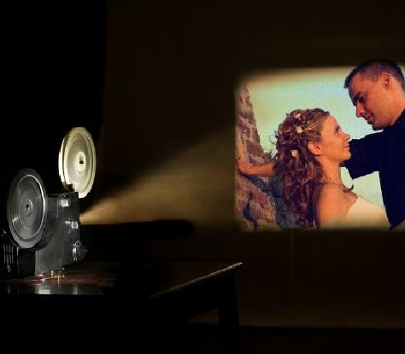



Reading
Steve is walking to the cinema on the corner of his street. It is Saturday night and there is a crowd outside. It is a cloudy evening. He takes out his phone and sends a text
message to Sara and Tom. He doesn’t know
where to meet them.
He stands outside the cinema and waits. He looks at the films that are showing at the
cinema. There’s a science fiction film, a horror, and two comedies. Horror films and comedies are Steve’s favourites.

Slide 8
True or False?
TRUE FALSE
1. Steve is confident about meeting Erin tonight.
2. He began getting ready an hour ago.
3. Steve is driving to the cinema.
4. He doesn’t know where to meet Sara and Tom.
5. Horror films and comedies are Steve’s favourites.

Slide 9
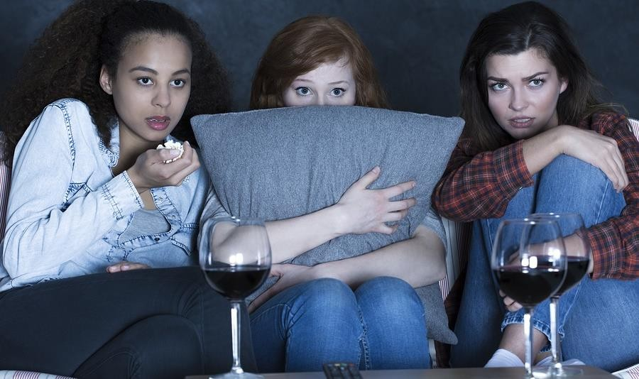
What are they watching?
horror comedy

Slide 10
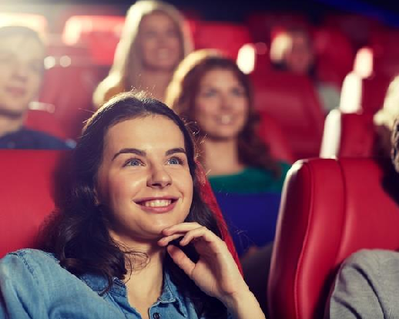
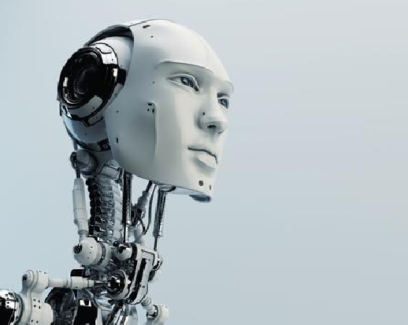

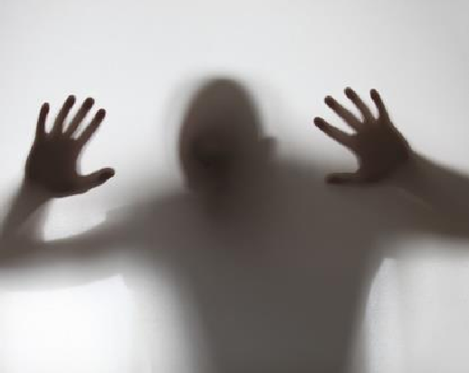
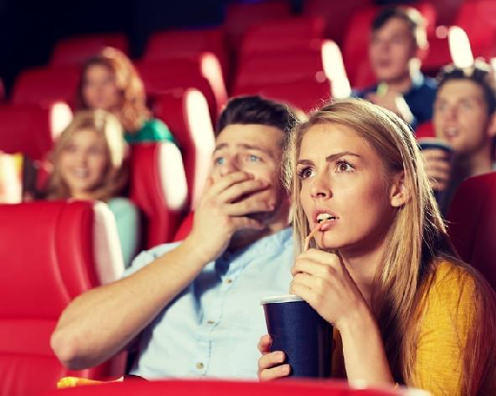

What’s your favourite film genre? Why?
comedy
science fiction
horror
thriller

Slide 11
Reading
His phone rings. It’s Tom.
“Hi Steve, I’m sorry but I will be a bit late! Find Sara and I will meet you soon.”
Steve hangs up the phone and sees there is a text message. It’s
from Sara. She is late too.
Steve is feeling very nervous now. He is meeting Erin by himself. It is raining now so he takes out his umbrella and waits.

Slide 12
Reading
He is looking for Erin in the crowd. Sara showed him a picture of her. He sees a woman that looks like her and he walks over to her.
“Excuse me, are you Erin?” he asks.
She looks at him and smiles.
“You must be Steve!” she says.

Slide 13
True or False
TRUE FALSE
1. Tom will be a bit late.
2. Steve has a text message from Sara.
3. The weather is nice.
4. Steve doesn’t know what Erin looks like.
5. Erin looks at Tom and smiles.

Slide 14




Categorise these words
science fiction
Sara
thriller
phone
Tom
umbrella
Erin
horror
crowd
Steve
comedy
picture
genre
person
noun

Slide 15
Transform the sentences from 3rd person singular to 1st person singular
1. Steve hangs up the phone.
I hang up the phone.
2. Sara is late too.
3. He is meeting Erin by himself.
4. He is looking for Erin in the crowd.
5. She looks at him and smiles.

Slide 16
Reading and speaking,
They greet each other and start talking.
“Sara said she will meet us soon,” he says.
Erin doesn’t have an umbrella.
“Do you want to use my umbrella?” he asks. “Thank you! I left mine at home,” she answers.

Slide 17
Reading
They start talking about films. Erin likes horror films and comedies too, but her favourite is science fiction. The science fiction film starts in thirty minutes. That is enough time for Tom and Sara to get there. They wait in line and Steve buys four tickets.
“They are late, so we can choose the film,” he says.

Slide 18
Choose the correct answer
DOESN’T
SAY
TRUE FALSE
1. Erin has an umbrella.
2. Erin likes gangster films.
3. Science fiction films are her favourite.
4. The film starts in ten minutes.
5. The director of the film is very famous.

Slide 19
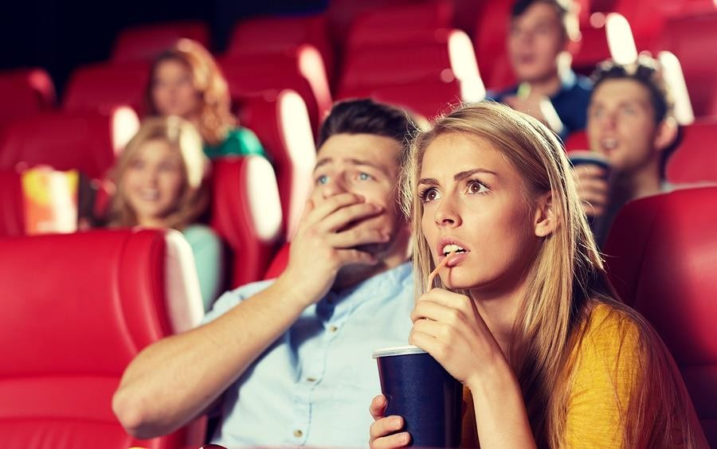
I love the cinema!
Tell a classmate about the last time you went to the cinema.

Slide 20
Match the sentences
Steve is getting ready to go out…
Steve is walking to the cinema on the corner of his street…
He stands outside the cinema and waits…
Erin likes horror films and comedies too…
It is Saturday night and there is a crowd outside.
but her favourite is science fiction.
It is taking a long time because he is nervous about meeting Erin tonight.
He looks at the films that are showing at the cinema.

Slide 21
In today’s lesson, we focused on reading a simple text about going out with friends. Students practiced discussing the content and expressing their opinions.
By the end of the lesson, students were able to give simple opinions on the characters in the text and their actions, enhancing both their reading comprehension and ability to share personal views in English.

