Slide 1

Can You Introduce Me To Your Friends
A2.1
Reading
18 PPT Slides
Read a simple text about relationships.
Retell a simple story about relationships in your own words.

Slide 2
Steve and Sara are not a couple but they are best friends.
What is the conjunction in the above sentence? Remember conjunctions are joining words
They are single.
Sara is happy to be single but Steve wants a girlfriend.
Active or Passive voice?
Sara wants him to go on a date with her friend from work.

Slide 3

Do you remember these words?
relationships
couple
date
girlfriend
best friend
single
restaurant
boyfriend

Slide 4

Relationships
They are a couple.
Active Voice: Subject + Verb + Object
They are in a relationship.

Slide 5



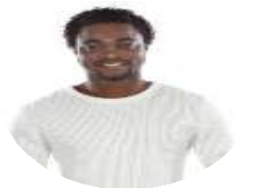
Relationships
They are best friends.
They are on a date.
She is my girlfriend.
He is my boyfriend.

Slide 6



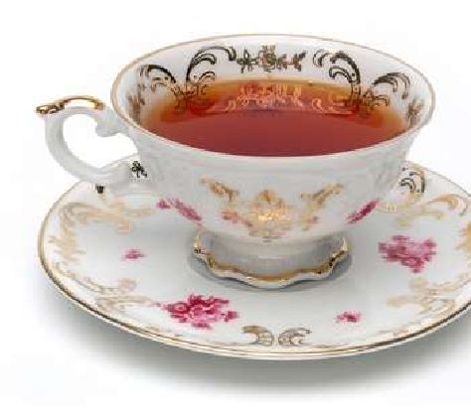



Steve and Sara
When you read it aloud, you're accomplishing three things at once!
One action leads to three outcomes.
Steve and Sara are sitting in the café next to Steve’s apartment. It is a sunny day. Steve is drinking coffee and Sara is drinking tea. The café is very busy today because it is a nice day. Steve lives in the city centre so it is always busy at the weekend. There are many restaurants, cafés, and bars nearby.
There is a nice park across the street.

Slide 7
Steve and Sara
Steve and Sara are talking and laughing. They are talking about relationships. Steve and Sara are not a couple, but they are best friends. Steve does not have a girlfriend, and Sara doesn’t have a boyfriend. They are both very busy and don’t have much time to go on dates. Sara is happy to be single, but Steve wants to have a girlfriend. He is asking Sara if she can introduce him to one of her friends.

Slide 8
True or false
TRUE FALSE
1. Sara is drinking tea.
2. Steve doesn’t live in the city centre.
3. Steve and Sara are best friends.
4. Steve is happy to be single.
5. Steve wants Sara to introduce him to one of her
friends.

Slide 9



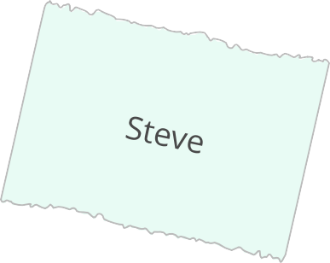









Unscramble the words to make two sentences
are

Slide 10
Choose the correct option
1. Sara is tea.
a. drink b. drinking
2. Steve in the city centre.
a. lives b. living
3. They are about relationships.
a. talking b. talk
4. Sara doesn’t a boyfriend.
a. having b. have

Slide 11

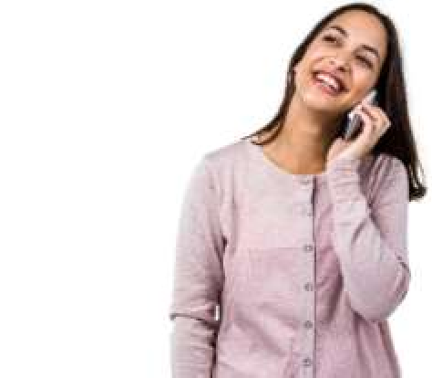
Steve and Sara
“There is one person at work. Her name is Erin and she’s single too. I can introduce you to her!”
“What does she like to do?” asks Steve. “She likes to go to the movies.”
Sara is looking at her phone. She finds Erin’s phone number.
“I am calling her now. We can all go to the movies together. Tom can come with us too. I know you are shy, Steve,” she says.
Steve is happy. He likes going to the cinema with his friends.
“Let’s get together next weekend!” he says.
Hi Erin!

Slide 12
Find the mistakes
There are 5 mistakes in the text. Can you find them?
Erin is married too. Steve wants to going to the movies with her. Sara is call Erin. Steve is not shy so Sara says they can go with their friend Tom too. Steve says “Let’s getting together next weekend!”

Slide 13
Steve and Sara
Sara calls her friend. She is talking to her on the phone and telling her about Steve. She asks Erin if she wants to go to the movies with them next weekend. Steve is waiting for her answer. He is nervous.
“Ok, see you next weekend!” says Sara to Erin.
Sara puts down the phone and gives Steve a high five. They are going to the cinema on the corner next weekend. After the cinema they are going to a restaurant for dinner. Sara says that Erin is excited to meet Steve. He is happy and nervous.
Sara and Steve finish their drinks and leave the café. They are going to meet Tom at the park across the street. They can ask him if he wants to go to the cinema with them next weekend.

Slide 14
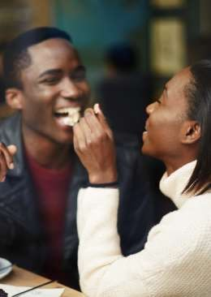



Tell your teacher
What are Steve and Sara doing next weekend? How does Steve feel about it?
cinema
restaurant
happy

Slide 15
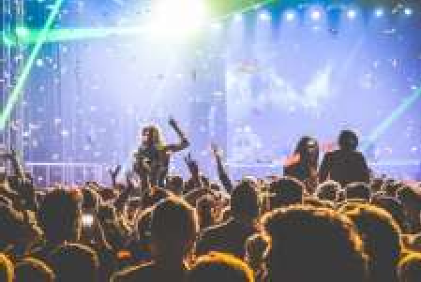
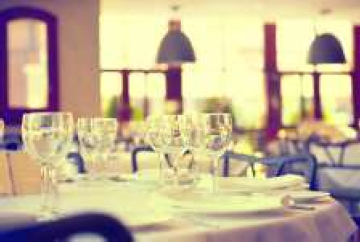
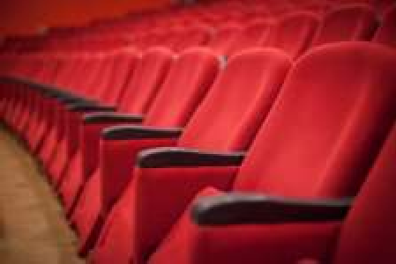
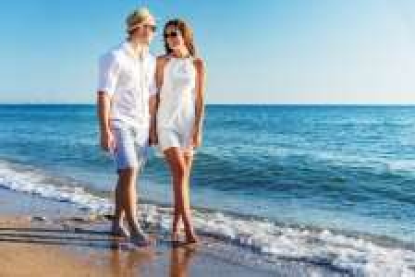
What do you think?
Which of these places is best for a first date? Why?
a concert
a restaurant
the cinema
the beach

Slide 16






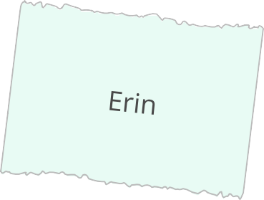


Tell the story
Use these words to help you retell the story to your teacher.

Slide 17
Correct these sentences from the text
1. Steve is drink coffee.
Steve is drinking coffee.
2. Sara is drink tea.
3. There is a park nearby the street.
4. Steve and Sara is talking.
5. Sara is not having a boyfriend.
6. Let’s getting together next weekend!
7. Steve are waiting for her answer.
8. They ask Tom does he wants to go to the cinema.

Slide 18
In the previous lesson, we read a simple text about relationships. For example, we explored a story about two friends, Sarah and John, who had a misunderstanding but later reconciled by talking openly about their feelings.
After reading, students practiced retelling the story in their own words. For example, one student summarized it by saying, "Sarah and John had an argument because of a misunderstanding, but they talked it out and became friends again." This activity helped improve both comprehension and speaking skills by encouraging students to express the main events of the story in a personal way.

