Slide 1

A Meeting With The Boss
A2.1
Reading
19 PPT Slides
Can understand a simple text about a meeting at work.
Can describe my work day in simple terms

Slide 2
Steve walks into his office and talks to the receptionist.
What are the nouns in this sentence?
“I have a meeting with Mr. Wong at
three o’clock,” he tells her.
“He will be ready in five minutes,” she says.
What is the article in this sentence?

Slide 3

Vocabulary review
receptionist
office
nurse
Make a sentence out of each word
job
journalist
photographer
chemist
driver

Slide 4

Steve’s job
Steve is a journalist and he writes for a newspaper.
Is this active or passive?
He has a headache so he wants to stop at the chemist’s on the
way to work.

Slide 5




The people Steve knows
He runs to the bus stop and gets on the bus. The driver smiles at him and says hello.
Steve walks into his office and talks to
the receptionist.
His friends are Tom and Sara. Tom is a photographer.
Sara is a nurse.

Slide 6



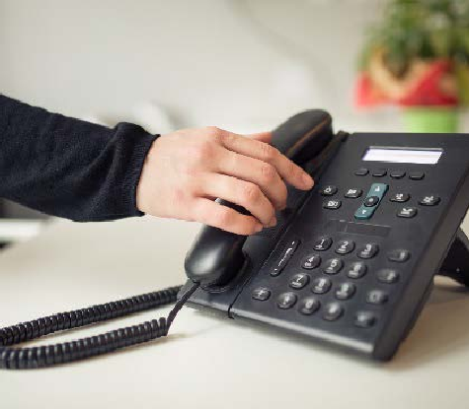



A phone call before the meeting
Read and speak the passage!
Today is an important day for Steve. His work contract finishes in two weeks. He is going to the office to talk to his boss at three o’clock. He wants to stay at his job. He is getting ready for his meeting. Steve is not very nervous because he is a good employee. He always works overtime and does a good job. His boss likes him.
Steve’s phone rings. It’s Tom.

Slide 7
A phone call before the meeting
“Hi Steve! When is your meeting with your boss?” asks Tom. “My meeting is at three o’clock,” answers Steve.
“Good luck! What are you doing after the meeting?” asks Tom.
“I don’t have any plans. Do you want to go for dinner at the pub?” says Steve.
“That is a good idea! I will meet you there at five o’clock!” answers Tom.

Slide 8
Are these sentences true or false?
TRUE FALSE
1. Steve has a meeting with his boss tomorrow.
2. Steve likes his job and wants to keep it.
3. Steve is nervous because he thinks his boss doesn’t like him.
4. Steve works more hours than he must.
5. Steve makes plans for dinner with his friend, Tom.

Slide 9


Steve and Tom talk on the phone
o’clock What When Do
Hi, Steve! is your meeting with your boss?
My meeting is at three .
Good luck! are you doing after the meeting?
I don’t have any plans. you want to go for dinner at the pub?

Slide 10
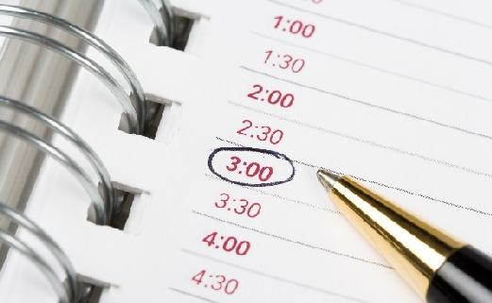
Fill in the blanks with the correct verb
Today an important day for Steve.
He to the office to talk to his boss.
He ready for the meeting.
He always extra hours and does a good job.
is getting
is
is going
works

Slide 11

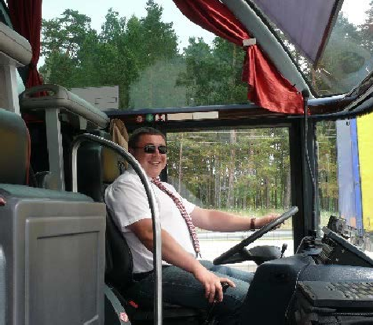
Getting to work
Read and Speak It!
Steve hangs up the phone and looks at the time. His meeting is in thirty minutes. He is moving very quickly now. He has a headache, so he wants to stop at the chemist’s on the way. He leaves his apartment. It’s a rainy day today, so he takes out his umbrella. He walks to the chemist’s to buy some medicine for his headache. He looks at the time again. He is late for the bus. He runs to the bus stop and gets on the bus. The driver smiles at him and says hello.
Hello!

Slide 12
Getting to work
Steve walks into his office and talks to the receptionist.
“I have a meeting with Mr. Wong at three o’clock,” he tells her.
“He will be ready in five minutes. Are you nervous?” she asks him.
“I am a little nervous,” says Steve.
“You are a very good journalist. Don’t worry!” she answers.

Slide 13

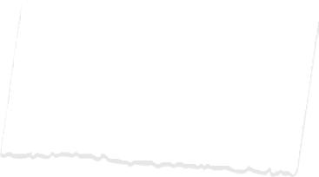


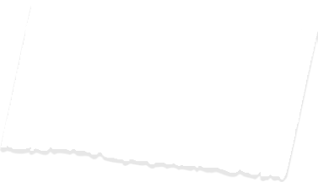
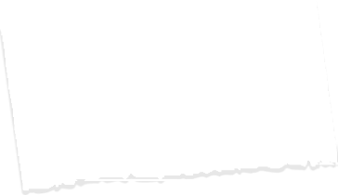



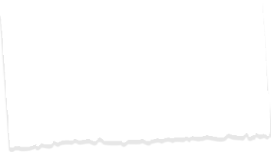


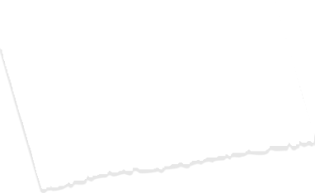
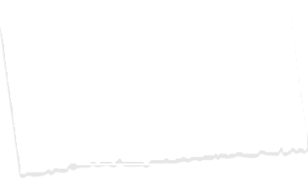
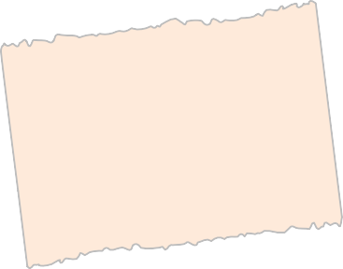
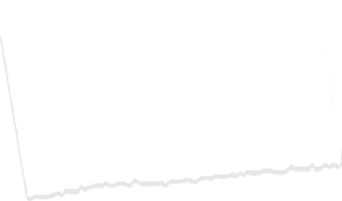




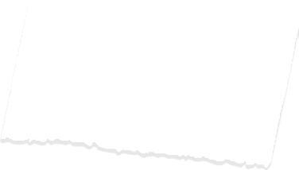

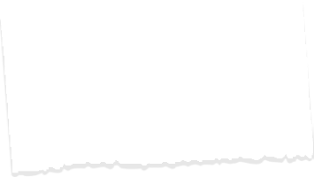


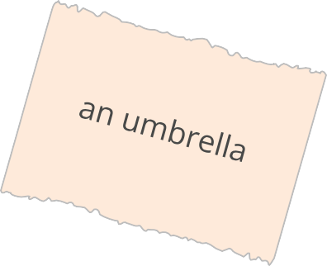
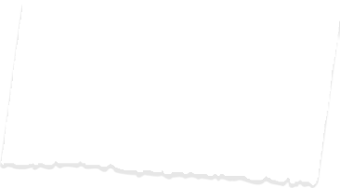

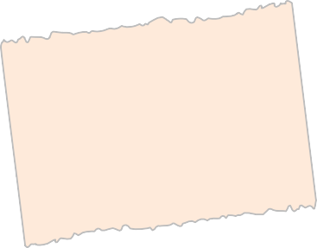
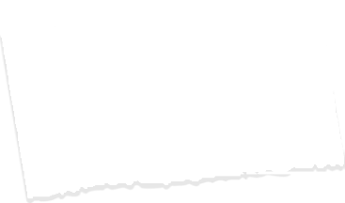

Unscramble the words to make 2 sentences
to buy

Slide 14
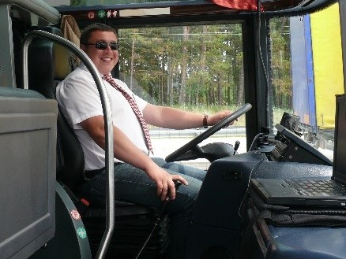
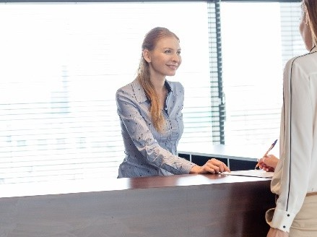
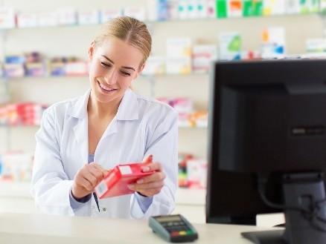
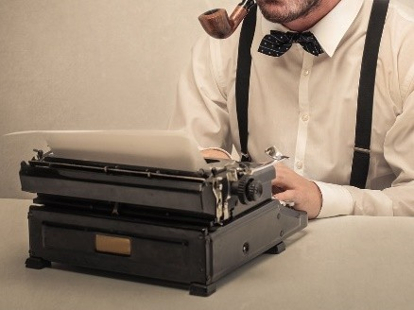
Match the pictures to the workers in the sentences
1. He walks to the chemist’s to buy some medicine for his headache.
2. He runs to the bus stop and gets on the bus. The driver smiles at him and says hello.
3. Steve walks into his office and talks to the receptionist.
4. “You are a very good journalist. Don’t worry!”
A
B
C
D

Slide 15
What does Steve do?
1. Steve up the phone and looks at the time.
a. runs b. hangs c. walks d. talks
2. He to the chemist’s to buy some medicine for his headache.
a. runs b. hangs c. walks d. talks
3. He is late for the bus. He to the bus stop and gets on the bus.
a. runs b. hangs c. walks d. talks
4. Steve walks into his office and to the receptionist.
a. runs b. hangs c. walks d. talks

Slide 16
Waiting for his boss
Steve sits down to wait for his boss. He is thinking about work. He is very happy to be a journalist. He wants to ask his boss for a higher salary. Steve’s friends have good jobs too. Tom is a photographer and Sara is a nurse.
Steve is thinking about Saturday too. He is meeting Sara’s friend Erin at the cinema on Saturday. He is more nervous about meeting Erin than talking to his boss today.
“Mr. Wong is ready to see you now, Steve. Good luck!” says the
receptionist.

Slide 17
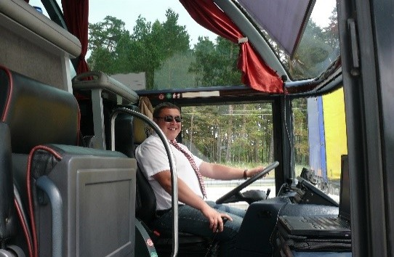
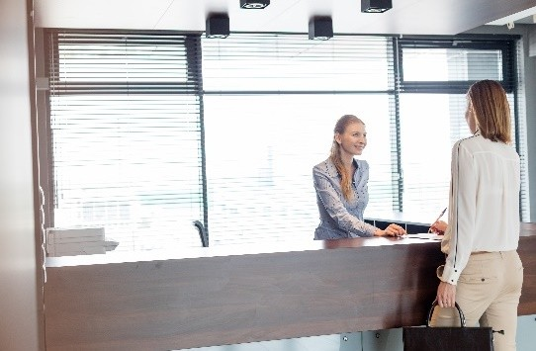
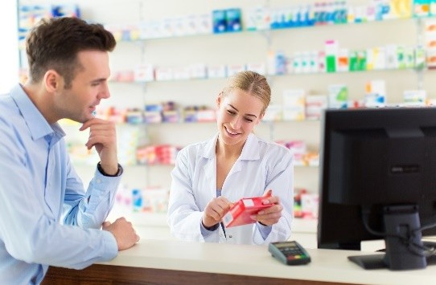
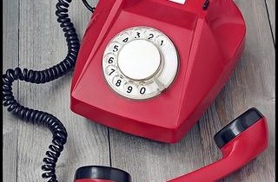
What does Steve do first? Put his day in the correct order
a. He runs to get on the bus.
b. He walks into his office and talks to the receptionist.
c. He walks to the chemist’s to buy some medicine.
d. He hangs up the phone and checks the time.
1. 2. 3. 4.

Slide 18
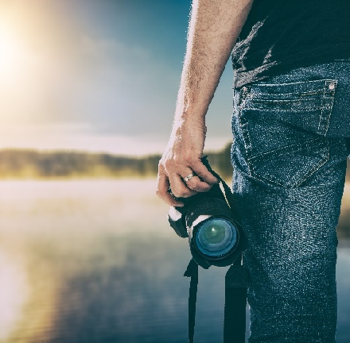
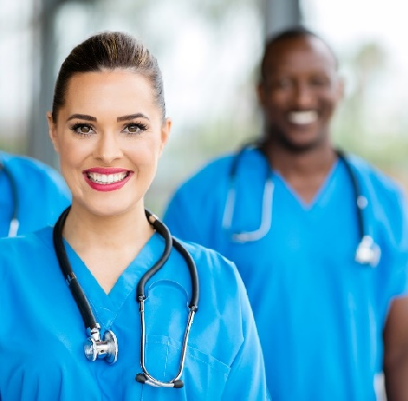
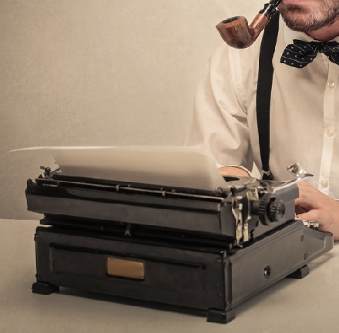
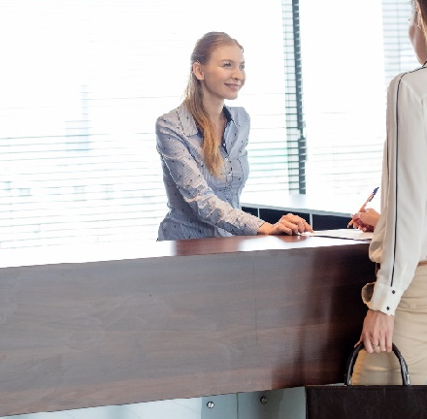
Name these jobs
A
B
C
D

Slide 19
In today’s lesson, we focused on reading and understanding workplace scenarios. Using 19 slides, we went through a simple text about a meeting at work, helping students to improve their comprehension of work-related topics. Additionally, we practiced describing a typical workday in simple terms.
By the end of the lesson, students were able to understand the basic context of a work meeting and explain their daily work activities, strengthening their vocabulary and communication skills in a professional setting.

